Slide 1
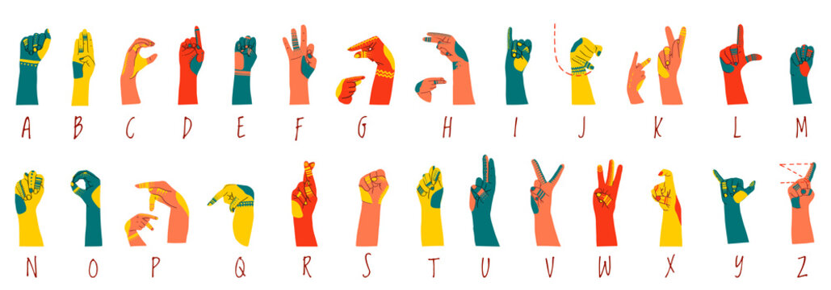
Sign Language Recognition Using CNN
By: Michael Tesis, Robert Cole Mullisa
Date: 3/2/2026
AI700-001_BK_Spring 2026

Slide 2
OUTLINES
Title
Outlines
Introduction: Motivation and Problem Definition
Application
Literature Review
Literature Review Results
Algorithm/Approach/Methodology
Project Timeline
Dataset Exploration
Understanding the Functions
Obtained Results
Conclusion and Future Work
References
Questions

Slide 3
INTRODUCTION
Motivation:
Create a practical CNN model capable of recognizing images of Sign Language gestures.
Learn how to apply fundamental Deep Learning concepts in practice.
Make a contribution to the development of SLR.
Demonstrate the performance of the chosen algorithm.
Problem Definition:
From an image containing a Sign Language gesture, we use Sign Language Recognition CNN model to recognize the gesture and output the corresponding English letter.

Slide 4
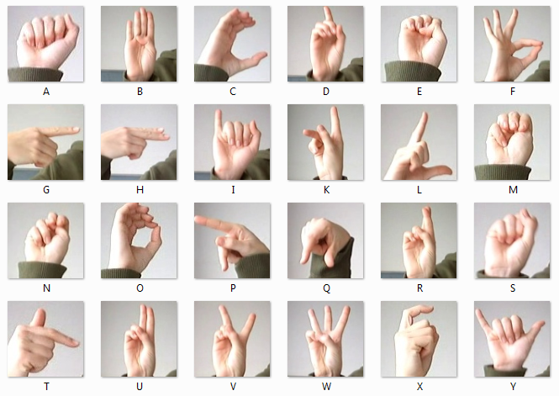
APPLICATION
Application for SLR:
Bridge communication between people who know Sign Language and those who don’t.
Improve communication between people who are hearing impaired.
A technology to learn Sign Language and test your knowledge.
Enable machines to recognize Sign Language in order to control them using gestures.
Facilitate communication in loud environments or places where silence is needed.

Slide 5
LITERATURE REVIEW
S. K. Hafiz Muhammad, S. D. Mcloughlin, and I. Murtagh in their 2025 paper “Comparative Evaluation and Utilization of Convolutional Neural Network Architectures for Irish Sign Language Recognition” demonstrate innovative technologies that apply SLR in everyday life. Their research evaluates the performance of different deep neural network architectures in the recognition of sign language.
H. A. Taher and S. R. M. Zeebaree in their 2025 paper “A Critical Study of Recent Deep Learning-Based Continuous Sign Language Recognition” present a comprehensive review of SLR, focusing specifically on Deep Learning techniques. The researchers reviewed 32 studies published by major publishers and examined 12 benchmark datasets related to SLR.
Y. Zhang and X. Jiang in their 2024 paper “Recent Advances on Deep Learning for Sign Language Recognition” present a comprehensive and up-to-date analysis of the advancements, challenges, and opportunities in deep learning-based sign language recognition, focusing on the past five years of research.

Slide 6
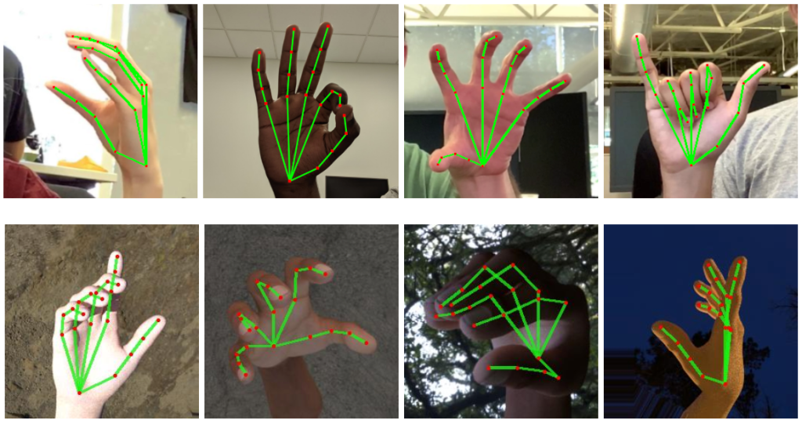
LITERATURE REVIEW RESULTS
Studying the related literature allowed us to:
Understand concept and inner workings of SLR.
Learn the architecture of SLR and all of the steps a CNN model would have to perform for SLR.
Learn different algorithms and techniques that can be used at each step.
Learn the challenges that SLR faces and possible solutions to them.

Slide 7
ALGORITHM/APPROACH/METHODOLOGY
Step 1
Preprocess images in the Convolutional layer by converting them to the format of the dataset, which is grayscale 28x28 pixels.
Step 2
Use filters, padding, and smoothing to eliminate noise and improve image quality.
Step 3
Extract important features out of the images.
Step 4
Reduce the size of the image in the Pooling layer to make the model more efficient.
Step 5
Train the Fully-connected layer of the model using the MNIST Sign Language dataset.
Step 6
Test and tune the parameters of the CNN to achieve the optimal accuracy.

Slide 8
PROJECT TIMELINE
The milestones with their corresponding expected dates for achievement:
Dates (Weeks) | Describe the Objectives and roadmap actions | Contributor(s)
Week 6 | Topic selection and proposal submission | Michael, Robert
Week 7 | Create a repository on GitHub | Robert
Week 8 | Data acquisition and pre-processing | Michael
Week 9 | Create structure for CNN model | Robert
Week 10 | Report project progress | Michael, Robert
Week 11 | Implement model using chosen source code | Michael
Week 12 | Train/test split | Robert
Week 13 | Evaluate and improve model based on test results | Michael
Week 14 | Repeat testing and improvement cycle | Robert
Week 15 | The final presentation of project results & discussion | Michael, Robert

Slide 9
DATASET EXPLORATION
We studied the datasets that were used in the papers that we studied in the Literature Review. Below are the papers and the corresponding datasets used in each paper:
Paper: “Comparative Evaluation and Utilization of Convolutional Neural Network Architectures for Irish Sign Language Recognition” (Muhammad et al., 2025)
Dataset: Marlon Oliveira's et al. Irish Sign Language hand-shape dataset (ISL-HS) (Oliveira et al., 2017)
Paper: “A Critical Study of Recent Deep Learning-Based Continuous Sign Language Recognition” (Taher et al., 2025)
Dataset: Publicly accessible CSLR benchmark datasets eg. RVL-SLLL (Martínez et al., 2002)
Paper: “Recent Advances on Deep Learning for Sign Language Recognition” (Zhang et al., 2024)
Datasets:
Oscar, K. (2019). Papers with code—MS-ASL dataset.
Sridhar, A., Ganesan, R. G., Kumar, P., Khapra, M. (2020). INCLUDE.
Dongxu (2023). WLASL: A large-scale dataset for Word-Level American sign language.
For our model we utilize the MNIST Sign Language Dataset [7]. It contains rich data of 28 x 28 images of grayscale ASL alphabet signs. The training set contains 27,455 images and labels and the testing set contains 7,172 images and labels.

Slide 10
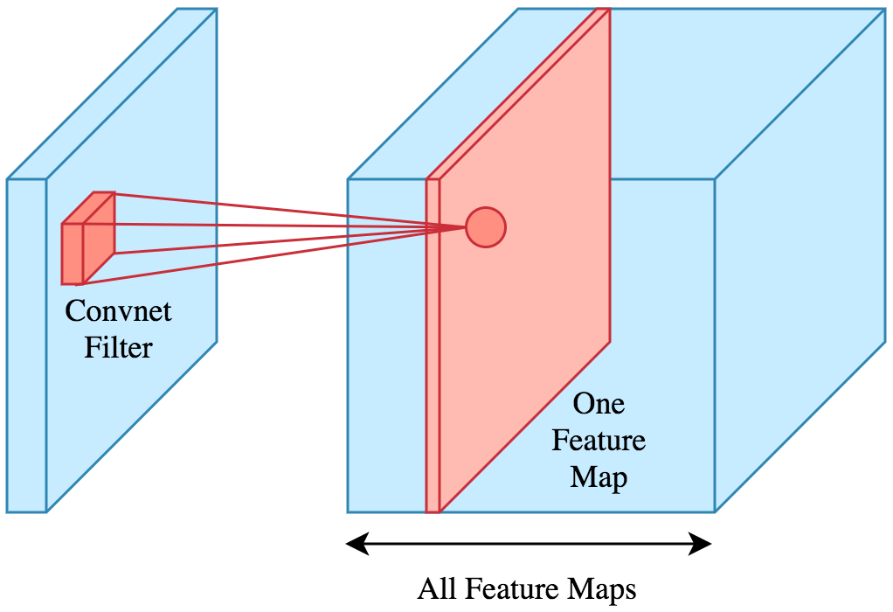

UNDERSTANDING THE FUNCTIONS
Before inputting the images into the neural network, they go through preprocessing functions that include filters, padding, smoothing, feature extraction, edge detection, etc.
Filters are small pixel matrices that traverse an image and perform specified functions based on the values given to the matrices in order to process images.
Padding is done in order for the image to retain its resolution when applying filters, so that no information is lost.
Smoothing eliminates image noisiness such as Gaussian noise, Salt and Pepper noise, random noise, and others.
Feature extraction finds specific features in the image that recognition can focus on. For example, edge detection emphasizes the edges, so that the contours are better defined.
The Fully-connected layer is the neural network itself that uses layers of interconnected neurons that transform input data using weighted sums and activation functions. During training, it adjusts its weights via backpropagation to minimize prediction error and learn patterns from data.

Slide 11
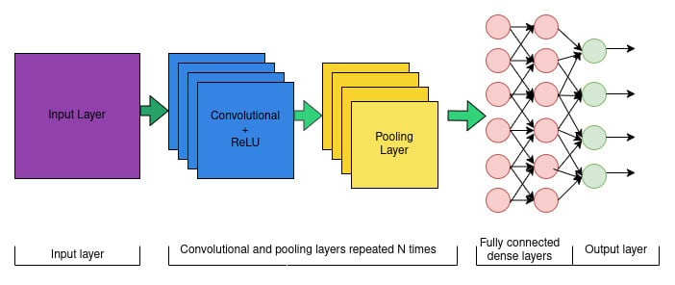
OBTAINED RESULTS
At this stage we obtained the following results:
Performed the literature review that allowed us to choose the Deep Learning model, such as CNN, that best fits our problem definition.
Selected the MNIST Sign Language dataset that is most appropriate for the intended purposes of our model.
Outlined the Convolutional, Pooling, and Fully-connected layers and their structures that we are going to use in the project.
Created a timeline for the implementation of our project.
Figure 1: Example of CNN architecture [4] that we will utilize.

Slide 12
CONCLUSION & FUTURE WORK
Conclusion:
Sign Language Recognition has become an important point of interest and research in recent years. Correspondingly, a lot of new research papers have been published that discuss the advances in the technology and challenges. At the same time, this is still a very novel area of study in AI application. Our project aims to make a contribution in the development of SLR by creating a CNN model that will recognize Sign Language gestures presented as images and translate them into text. Our goal is to achieve the best performance possible and high accuracy of at least 90% or higher during recognition. We hope our project will be able to practically help many people.
Future Work:
At this time, our next steps are to implement the CNN model, train it using the MNIST Sign Language dataset, and tune the model to achieve the best performance possible during testing. The end goal is to demonstrate how the program works using images obtained in real time. The long term plan is to recognize continuous Sign Language gestures presented as a video rather than a series of static images.

Slide 13
REFERENCES
Abdullah, A., Amoudi, G. A., & Alghamdi, H. S. (2024). Advancements in Sign Language Recognition: A Comprehensive Review and Future Prospects. IEEE Access, 12, 128871–128895.
Alam, I., Hameed, A., & Riaz, A. Z. (2024). Exploring Sign Language Detection on Smartphones: A Systematic Review of Machine and Deep Learning Approaches. Advances in Human - Computer Interaction, 2024.
Ankita, W., & Parteek, K. (2021). Sign Language Recognition Systems: A Decade Systematic Literature Review. Archives of Computational Methods in Engineering, 28(3), 785-813.
Codecademy. (2025, March 27). Understanding Convolutional Neural Network (CNN) Architecture. Codecademy. https://www.codecademy.com/article/ understanding-convolutional-neural-network-cnn-architecture.
Nagagopiraju, V., Reddy, Y. V., Raju, C. S., Sai, N. S., & Vishnu, N. (2025). Deep Learning and Computer Vision Based Sign Language Dynamic Gesture Recognition System. International Journal of Communication Networks and Information Security, 17(3), 89-95.
Rastgoo, R., Kiani, K., & Escalera, S. (2021). Sign Language Recognition: A Deep Survey. Expert Systems with Applications, 164, 1.
Sign Language MNIST. (n.d.). Www.kaggle.com. https://www.kaggle.com/datasets/ datamunge/sign-language-mnist
Varma, D. M., & Ch. Sekhar. (2024). Advances in AI for Automatic Sign Language Recognition: A Comparative Study of Machine Learning Approaches. I-Manager's Journal on Software Engineering, 19(2), 10.

Slide 14
Questions

